Slide 1
Robot mechanical assembly
This document describes the mechanical assembly of the field mapping robot

Slide 2
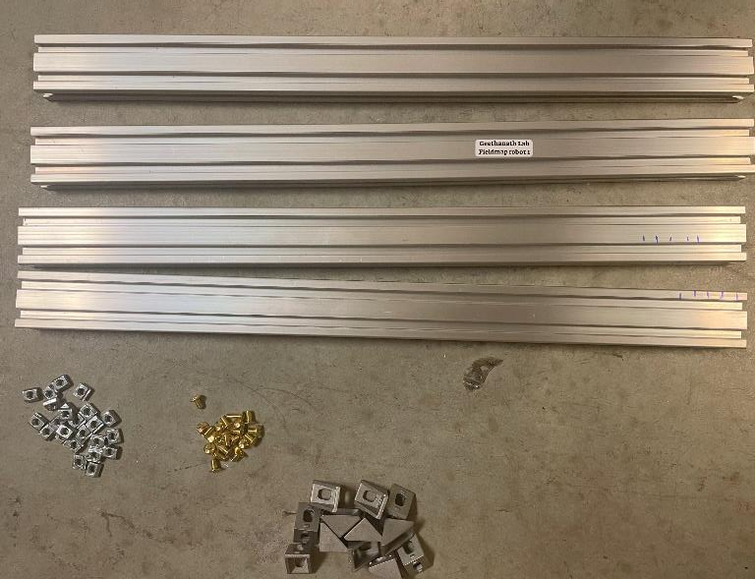
Stage 1
Requirements
Quantity | Part Description
4 | Aluminum profiles(500x40x20)mm3
16 | Aluminum corner brackets 40x20mm
20 | M5 Slot nuts
16 | M5 brass screws

Slide 3
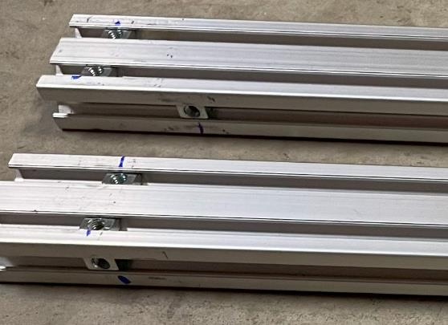
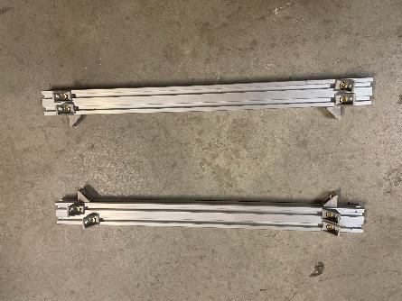
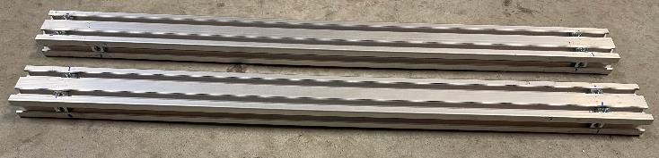
Step 1
step3
Step 4
Take two aluminum frames and insert 2 slot nuts at each end of the frames
Add an additional slot nut in the perpendicular part of the profile
Fix the corner brackets to these two aluminum frames using the screws

Slide 4
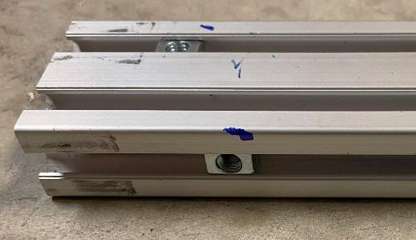
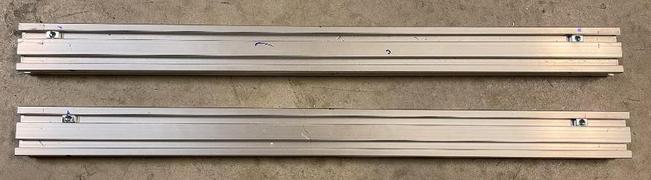
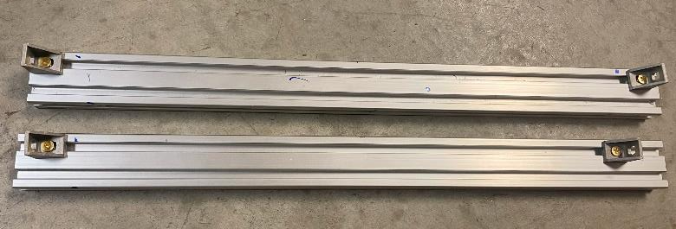
Step 6
Step 5
Add a slot nut in the perpendicular part of the profile
Take the other two aluminum frames and insert 1 slot nut at each end of the frames
step7
Fix two corner brackets on top of these two aluminum frames using the screws

Slide 5
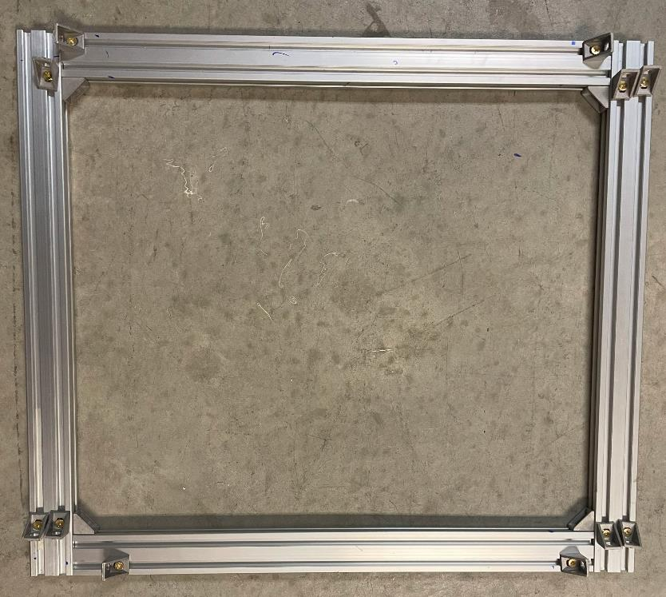
Step 8
Screw the two profiles in step 7 to the perpendicular corner brackets of the profiles in step 4

Slide 6
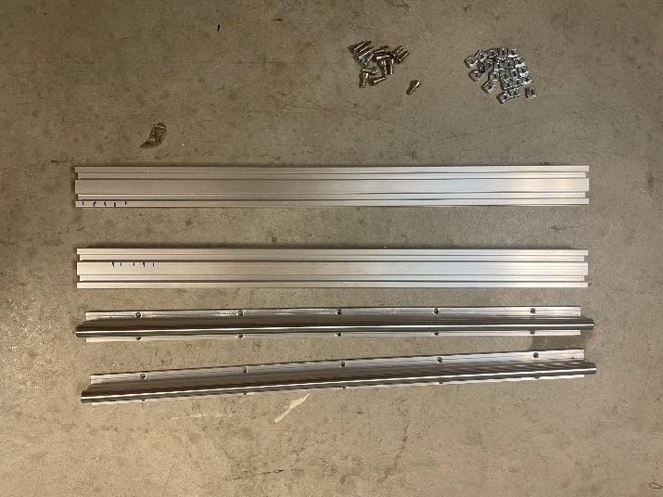
Stage 2
Requirements
Quantity | Part Description | Number
2 | Aluminum profiles(500x40x20)mm3
10 | M5 Slot nuts
10 | M5 screws
2 | Linear guides

Slide 7
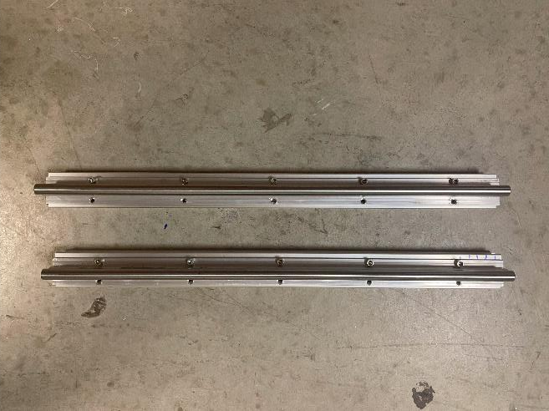
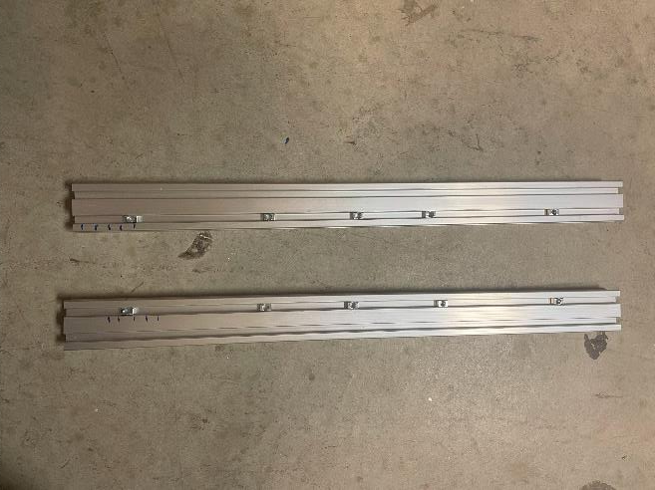
Step 9
Step 10
Take two aluminum frames and insert 5 slot nuts to each of the frames
Fix the linear guides to the two aluminum frames using the screws

Slide 8
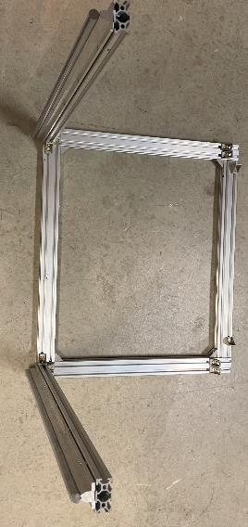
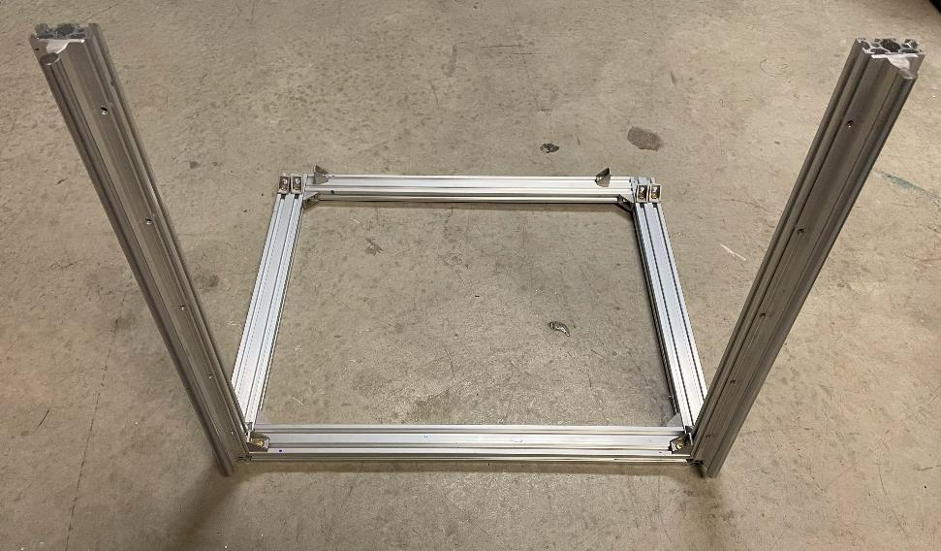
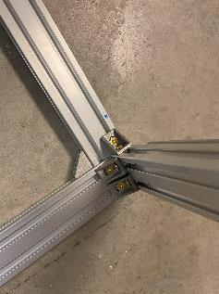
Step 11
Fix the assemblies in step 10 to the assembly in step 8 as shown below using screws

Slide 9
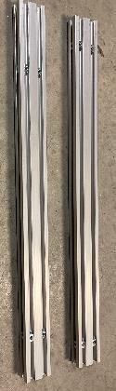
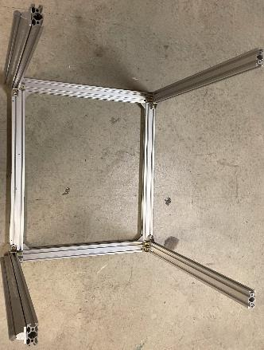
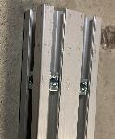
Stage 3
Requirements
step 12
step 13
Quantity | Part Description
2 | Aluminum profiles(500x40x20)mm3
12 | M5 Slot nuts
6 | M5 screws
Take two aluminum profiles and insert 2 slot nuts to each end of the profiles, Add a slot nut on one side of the perpendicular part of the two profiles
Fix the assemblies in step 12 to the assembly in step 11 as shown below using screws

Slide 10
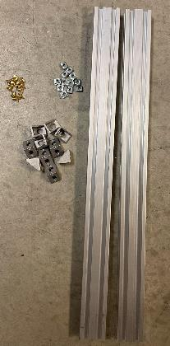
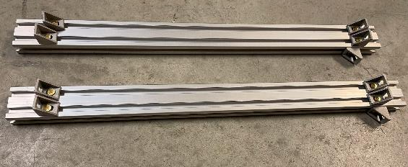
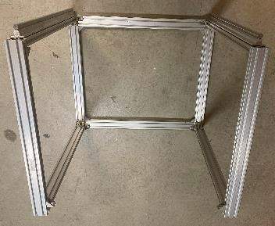
Stage 4
Requirements
Quantity | Part Description
2 | Aluminum profiles(500x40x20)mm3
10 | M5 Slot nuts
18 | M5 screws
10 | Corner bracket
step 15
step 14
Take two aluminum profiles and insert 2 slot nuts to each end of the profiles, Add a slot nut to one side of the perpendicular part of the two profiles, and fix corner brackets using screws
Fix the assemblies in step 14 to the assembly in step 13 as shown below using screws

Slide 11
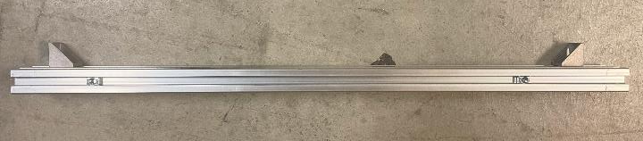
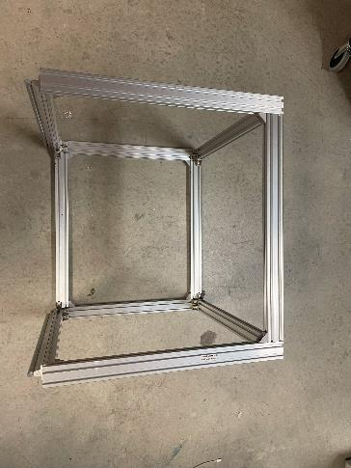
Stage 5
Requirements
Quantity | Part Description
1 | Aluminum profiles(500x40x20)mm3
4 | M5 Slot nuts
4 | M5 screws
2 | Corner bracket
step 17
step 16
Take 1 aluminum profile and insert 1 slot nut to each end of the profiles, Add a slot nut to one side of the perpendicular part of the two profiles, and fix corner brackets to the nuts on top of the profile using screws
Fix the assemblies in step 16 to the assembly in step 15 as shown above using screws

Slide 12
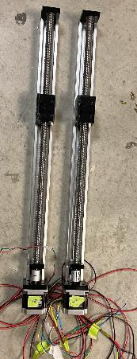
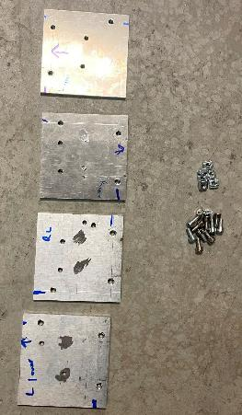
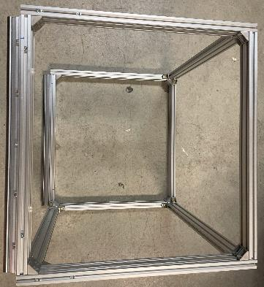
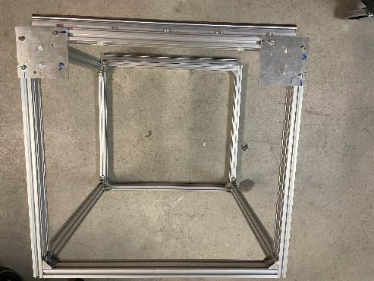
Stage 6
Requirements
Quantity | Part Description
4 | Aluminum square plates
12 | M5 Slot nuts
12 | M5 screws
2 | Linear actuators
step 17
Fix the two aluminum plates to the assembly in step 15 (on the side of the linear guides) as shown above using screws
Lay the assembly in step 17 by the side

Slide 13
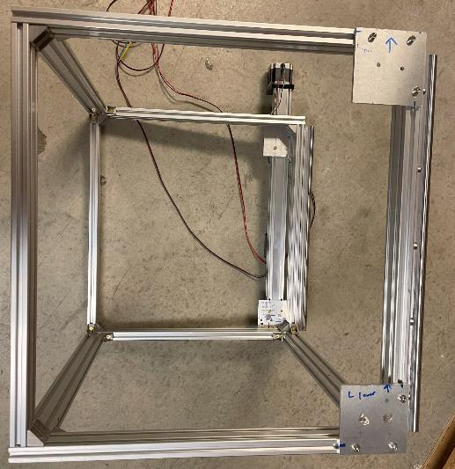
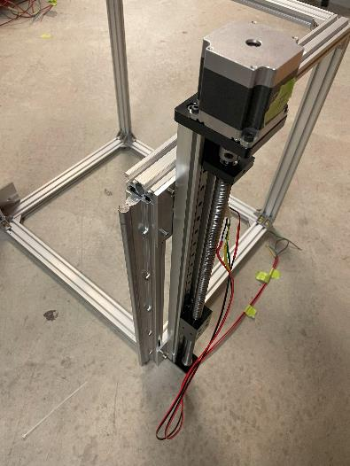
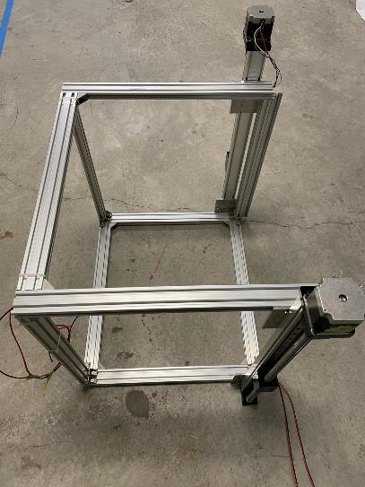
step 18
step 19
Fix the remaining two aluminum plates to the other side of the assembly in step 15 (on the side of the linear guides) as shown above using screws. Fix the linear actuator to the plates using m5screws
Fix the other linear actuator to the remaining aluminum plates as shown above using screws

Slide 14
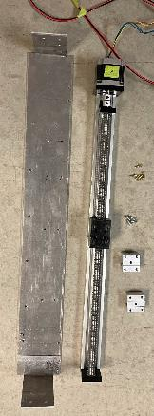
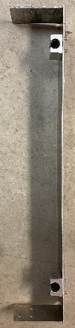
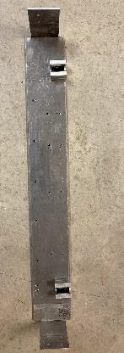
Stage 7
Requirements
Quantity | Part Description
1 | Aluminum square bracket
2 | Linear guide rail top
12 | M5 screws
1 | Linear actuators
step 19
Fix the two linear guide rail tops to the aluminum square bracket as shown above using screws

Slide 15
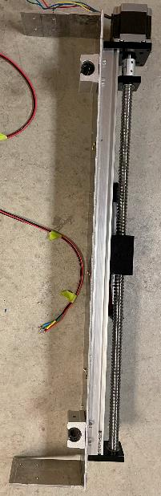
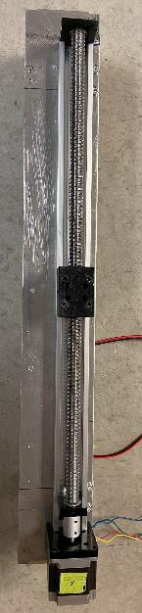
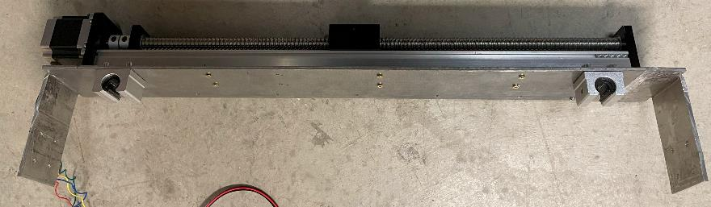
step 20
Fix the linear actuator to the other side of the aluminum bracket as shown above using screws

Slide 16
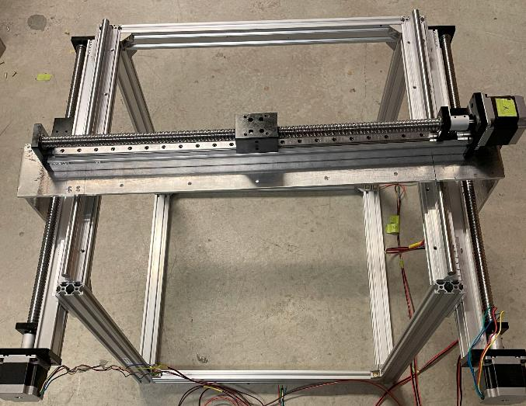
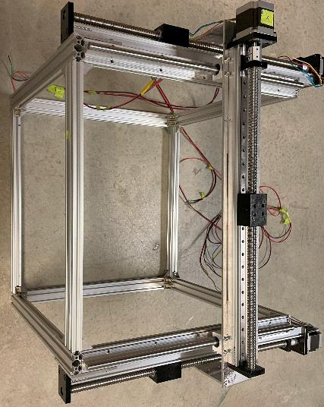
step 20
Fix the assembly in step 20 to the assembly in step 19 as shown above using screws.

Slide 17
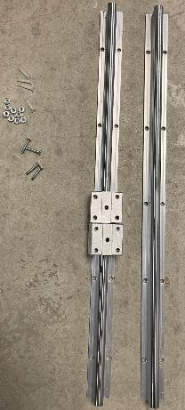
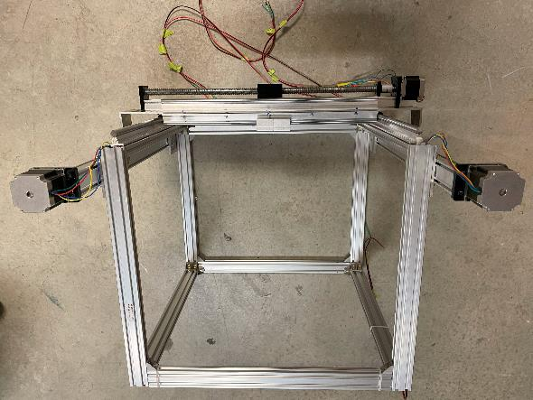
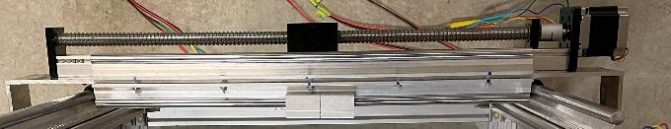
Stage 8
Requirements
Quantity | Part Description
2 | Linear guide
12 | M2 screws and nuts
step 21
Fix the two linear guides to the corner bracket as shown above using screws.

Slide 18
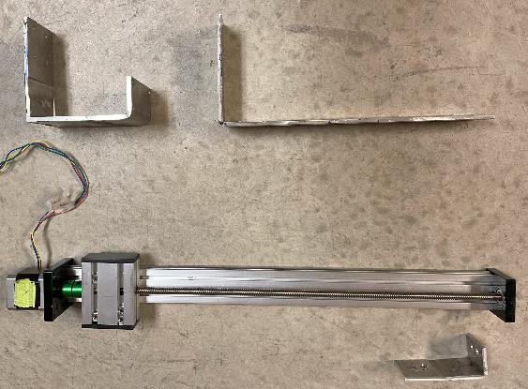
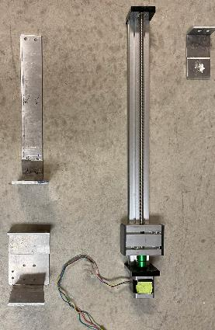
Stage 9
Requirements
Quantity | Part Description
1 | custom made aluminum corner bracket
2 | Linear guide rail top
12 | M5 screws
1 | Linear actuator

Slide 19
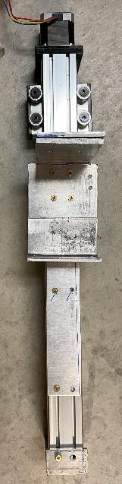
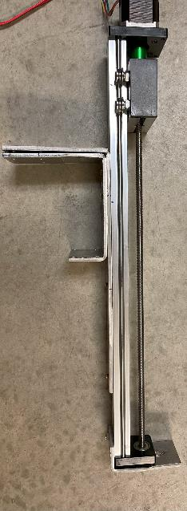
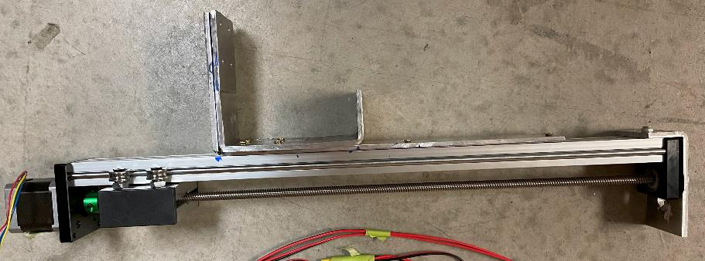
step 22
Fix the two corner brackets to the linear actuator as shown above using screws.

Slide 20
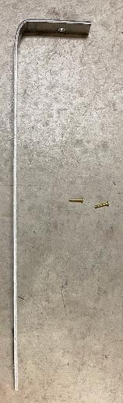
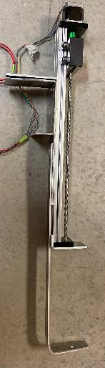
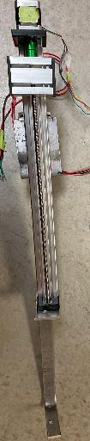

Stage 10
Requirements
Quantity | Part Description
1 | Custom made aluminum bracket
step 23
Fix the corner bracket to the linear actuator as shown above using screws.

Slide 21
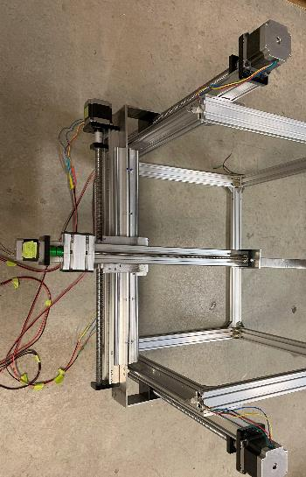
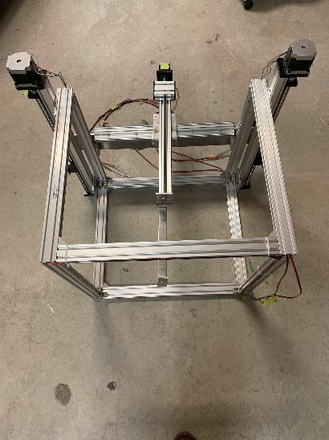


step 24
Fix the assembly(setup 23) to the assembly(set up 21) as shown above using screws.

Slide 22



Stage 11
Requirements
Quantity | Part Description
1 | Custom made aluminum bracket(rod holders).
1 | Aluminum rod
Fix the rod holders to the actuators of assembly 23(step 23) as shown above using screws.

Slide 23

Stage 12
Fix the rod holders to the actuators of assembly 23(step 23) as shown above using screws.

